Slide 1


CO5-AT3 TECHNICAL PRESENTATION
MLA0408-DEEP LEARNING
Generative Adversarial Networks (GANs)
Generator–Discriminator Framework, Adversarial Training, Applications and Comparison with Autoencoders
Guided By
Dr.D.Sudhagar
Presented by :
S.Mahammed Nayeem (192425294)

Slide 2
INTRODUCTION
Generative Adversarial Networks (GANs) are deep learning models used to generate new and realistic data.
GANs consist of two neural networks: Generator and Discriminator.
The Generator creates synthetic data from random noise.
The Discriminator distinguishes between real data and generated data.
Both networks are trained together through an adversarial learning process.
The Generator continuously improves its ability to create realistic samples.
GANs can generate images, videos, audio, and other synthetic data.
They are widely used in image generation, data augmentation, healthcare, gaming, and creative applications.

Slide 3
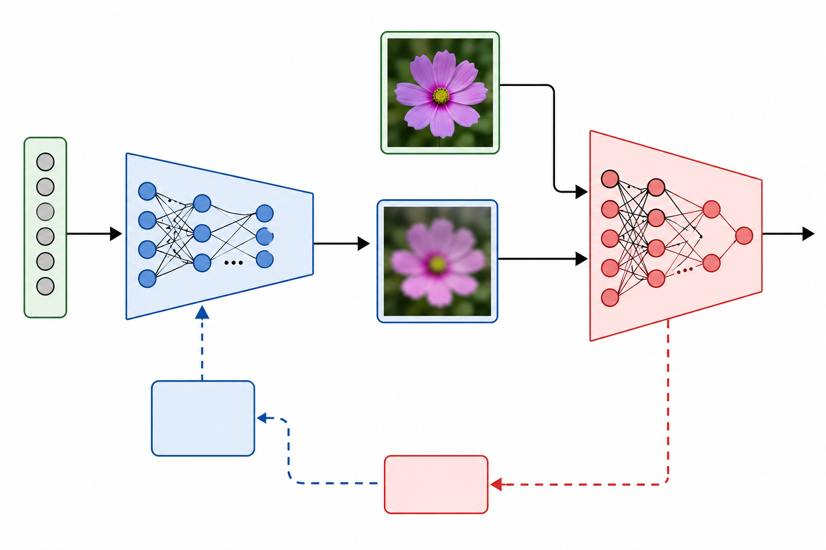
GAN Architecture
Generator and Discriminator Framework
Generator:
Takes random noise as input.
Converts noise into synthetic data.
Attempts to create realistic samples.
Improves its output based on discriminator feedback.
Discriminator:
Receives real and generated samples.
Predicts whether the input is real or fake.
Provides feedback to the generator.

Slide 4
Working of Generator
Generator Network
Generator is responsible for creating synthetic samples.
Input is a random noise vector z.
Neural network transforms the noise into meaningful data.
Initially, generated samples are usually poor.
Through training, the generator learns the distribution of real data.
The objective is to fool the discriminator.

Slide 5
COMPARISION BETWEEN GAN vs Autoencoder
Feature | GAN | Autoencoder
Main Purpose | Generate realistic data | Learn representations
Architecture | Generator + Discriminator | Encoder + Decoder
Training | Adversarial training | Reconstruction loss
Output Quality | Highly realistic | Often smoother
Data Generation | Excellent | Moderate
Reconstruction | Not the main focus | Excellent

Slide 6
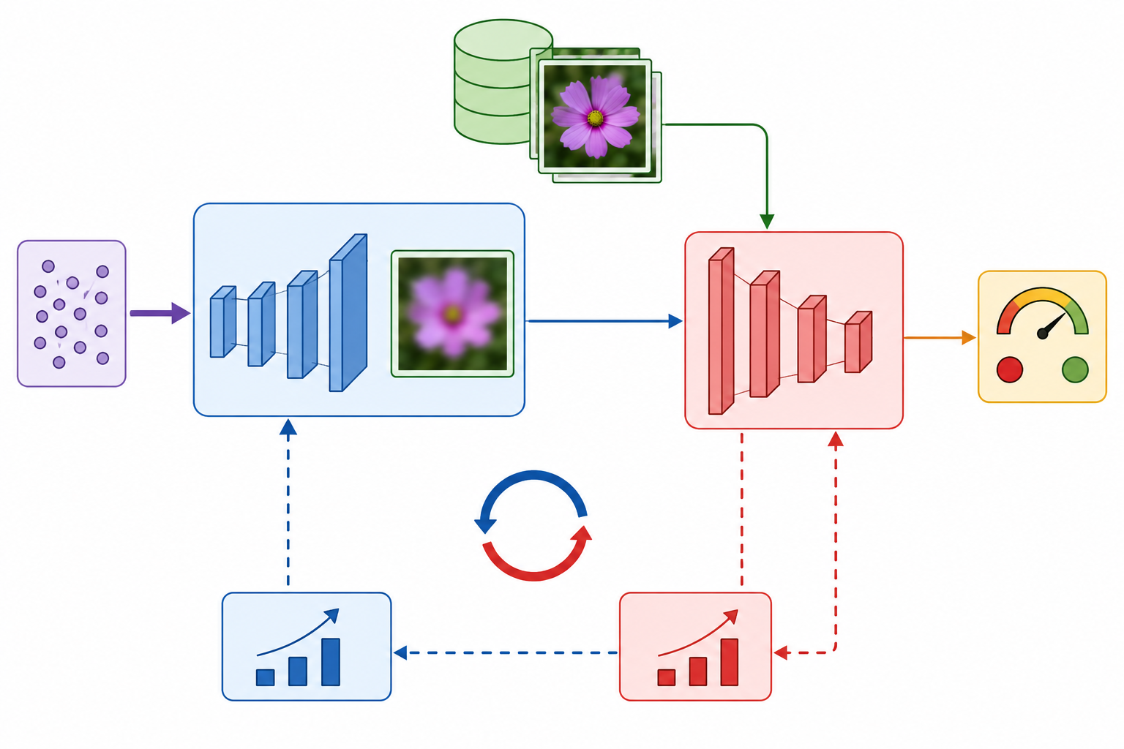
Adversarial Training Process
Generator vs Discriminator
Random noise is given to the Generator.
Generator produces synthetic samples.
Real and synthetic samples are given to the Discriminator.
Discriminator identifies real and fake samples.
Discriminator updates its parameters.
Generator receives feedback from the discriminator.
Generator updates its parameters.
Steps are repeated until realistic samples are produced.

Slide 7
REAL-WORLD APPLICATIONS
Image Generation: Creating realistic human faces and objects.
Healthcare: Generating synthetic medical images for research.
Image-to-Image Translation: Converting sketches into realistic images.
Super Resolution: Increasing image resolution.
Data Augmentation: Creating additional training samples.
Fashion: Generating new clothing designs.
Video Generation: Creating and modifying video content.
Gaming: Generating textures, characters, and environments.
Art and Design: Creating artistic and creative content.
Synthetic Training Data: Supporting machine-learning systems when real data is limited.

Slide 8
CONCLUSION
GANs are powerful generative deep learning models for creating realistic synthetic data.
They use two competing networks: Generator and Discriminator.
Adversarial training continuously improves the quality of generated samples.
GANs can generate realistic images, videos, audio, and other data.
They are useful for data augmentation, image synthesis, healthcare, gaming, and creative applications.
GANs can produce more realistic outputs than traditional autoencoders in many generation tasks.

Slide 9


